Slide 1

Chapter 4 Network Layer:
Data Plane
A note on the use of these PowerPoint slides:
We’re making these slides freely available to all (faculty, students, readers). They’re in PowerPoint form so you see the animations; and can add, modify, and delete slides (including this one) and slide content to suit your needs. They obviously represent a lot of work on our part. In return for use, we only ask the following:
If you use these slides (e.g., in a class) that you mention their source (after all, we’d like people to use our book!)
If you post any slides on a www site, that you note that they are adapted from (or perhaps identical to) our slides, and note our copyright of this material.
For a revision history, see the slide note for this page.
Thanks and enjoy! JFK/KWR
All material copyright 1996-2020
J.F Kurose and K.W. Ross, All Rights Reserved
Computer Networking: A Top-Down Approach 8th edition Jim Kurose, Keith Ross Pearson, 2020
Notes:
Version History
8.0 (May 2020)
All slides reformatted for 16:9 aspect ratio
All slides updated to 8th edition material
Use of Calibri font, rather that Gill Sans MT
Add LOTS more animation throughout
added new 8th edition material on middleboxes (and Internet arch), Net neutrality, buffering …
lighter header font

Slide 2








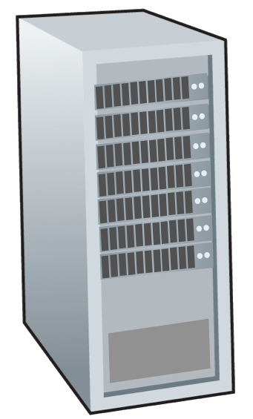







Network-layer services and protocols
transport segment from sending to receiving host
sender: encapsulates segments into datagrams, passes to link layer
receiver: delivers segments to transport layer protocol
network layer protocols in every Internet device: hosts, routers
routers:
examines header fields in all IP datagrams passing through it
moves datagrams from input ports to output ports to transfer datagrams along end-end path
mobile network
national or global ISP
application
transport
network
link
physical
network
link
physical
network
link
physical
network
link
physical
network
link
physical
network
link
physical
datacenter
network
application
transport
network
link
physical
enterprise
network

Slide 3

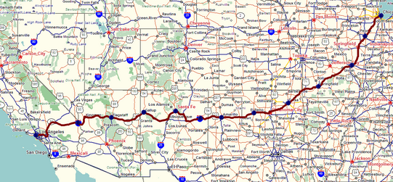
Two key network-layer functions
network-layer functions:
forwarding: move packets from a router’s input link to appropriate router output link
analogy: taking a trip
forwarding: process of getting through single interchange
routing: process of planning trip from source to destination
routing: determine route taken by packets from source to destination
routing algorithms
forwarding
routing

Slide 4
Network layer: data plane, control plane
Data plane:
local, per-router function
determines how datagram arriving on router input port is forwarded to router output port
Control plane
network-wide logic
determines how datagram is routed among routers along end-end path from source host to destination host
values in arriving
packet header
0111
1
3
2

Slide 5

Per-router control plane
Individual routing algorithm components in each and every router interact in the control plane
Routing
Algorithm
control
plane
data
plane
values in arriving
packet header
0111
1
3
2

Slide 6
Network Layer: Internet
host, router network layer functions:
transport layer: TCP, UDP
IP protocol
datagram format
addressing
packet handling conventions
Path-selection algorithms: implemented in
routing protocols (OSPF, BGP)
network
layer
forwarding
table
ICMP protocol
error reporting
router “signaling”
link layer
physical layer

Slide 7
Router architecture overview
high-level view of generic router architecture:
routing, management
control plane (software)
operates in millisecond
time frame
routing
processor
forwarding data plane (hardware) operates in nanosecond timeframe
high-speed
switching
fabric
router input ports
router output ports

Slide 8
Input port functions
lookup,
forwarding
queueing
line
termination
link
layer
protocol
(receive)
switch
fabric
physical layer:
bit-level reception
decentralized switching:
using header field values, lookup output port using forwarding table in input port memory (“match plus action”)
goal: complete input port processing at ‘line speed’
input port queuing: if datagrams arrive faster than forwarding rate into switch fabric
link layer:
e.g., Ethernet
(chapter 6)

Slide 9
Input port functions
lookup,
forwarding
queueing
line
termination
link
layer
protocol
(receive)
switch
fabric
physical layer:
bit-level reception
decentralized switching:
using header field values, lookup output port using forwarding table in input port memory (“match plus action”)
destination-based forwarding: forward based only on destination IP address (traditional)
link layer:
e.g., Ethernet
(chapter 6)

Slide 10
IP Datagram format
32 bits
IP protocol version number
head.
len
type of
service
total datagram
length (bytes)
ver
length
header length(bytes)
“type” of service:
diffserv (0:5)
ECN (6:7)
flgs
fragment
offset
fragmentation/
reassembly
16-bit identifier
time to
live
upper
layer
header
checksum
header checksum
TTL: remaining max hops
(decremented at each router)
source IP address
32-bit source IP address
destination IP address
Maximum length: 64K bytes
Typically: 1500 bytes or less
upper layer protocol (e.g., TCP or UDP)
32-bit destination IP address
overhead
options (if any)
e.g., timestamp, record route taken
20 bytes of TCP
20 bytes of IP
= 40 bytes + app layer overhead for TCP+IP
payload data
(variable length,
typically a TCP
or UDP segment)

Slide 11
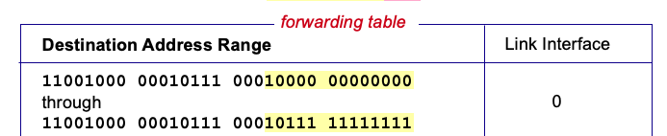

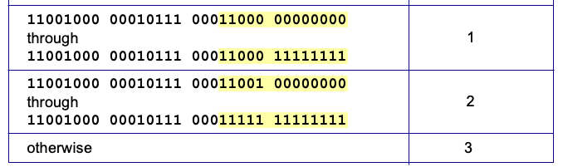
Destination-based forwarding
3
Q: but what happens if ranges don’t divide up so nicely?
Notes:
Text for this animation:
This all works out pretty nice and looks pretty simple!
But of course the devil is in the details, as the saying goes.
What happens, for example, when a subset of addresses say in this first range should go to say interface 3, rather than interface 0. Well, of course we could split the first address range into multiple pieces, and add in this new subrange with its new destination output port. But it turns out there’s a much simpler and elegant way to do this. Known as longest prefix matching.

Slide 12
Longest prefix matching
longest prefix match
when looking for forwarding table entry for given destination address, use longest address prefix that matches destination address.
Destination Address Range
11001000 00010111 00010
11001000 00010111 00011000
11001000 00010111 00011
otherwise
Link interface
0
1
2
3
***
********
********
***
********
examples:
11001000 00010111 00010110 10100001
which interface?
11001000 00010111 00011000 10101010
which interface?

Slide 13
Longest prefix matching
longest prefix match
when looking for forwarding table entry for given destination address, use longest address prefix that matches destination address.
Destination Address Range
11001000 00010111 00010
11001000 00010111 00011000
11001000 00010111 00011
otherwise
Link interface
0
1
2
3
***
********
********
match!
***
********
examples:
11001000 00010111 00010110 10100001
which interface?
11001000 00010111 00011000 10101010
which interface?

Slide 14
Longest prefix matching
longest prefix match
when looking for forwarding table entry for given destination address, use longest address prefix that matches destination address.
Destination Address Range
11001000 00010111 00010
11001000 00010111 00011000
11001000 00010111 00011
otherwise
Link interface
0
1
2
3
***
********
********
***
********
match!
examples:
11001000 00010111 00010110 10100001
which interface?
11001000 00010111 00011000 10101010
which interface?

Slide 15
Longest prefix matching
longest prefix match
when looking for forwarding table entry for given destination address, use longest address prefix that matches destination address.
Destination Address Range
11001000 00010111 00010
11001000 00010111 00011000
11001000 00010111 00011
otherwise
Link interface
0
1
2
3
***
********
********
***
********
match!
examples:
11001000 00010111 00010110 10100001
which interface?
11001000 00010111 00011000 10101010
which interface?

Slide 16
Longest prefix matching
we’ll see why longest prefix matching is used shortly, when we study addressing
longest prefix matching: often performed using ternary content addressable memories (TCAMs)
content addressable: present address to TCAM: retrieve address in one clock cycle, regardless of table size
Cisco Catalyst: ~1M routing table entries in TCAM

Slide 17
Switching fabrics
transfer packet from input link to appropriate output link
switching rate: rate at which packets can be transferred from inputs to outputs
often measured as multiple of input/output line rate
N inputs: switching rate N times line rate desirable
R
(rate: NR, ideally)
R
. . .
high-speed
switching
fabric
. . .
N input ports
N output ports
R
R

Slide 18
Switching fabrics
transfer packet from input link to appropriate output link
switching rate: rate at which packets can be transfered from inputs to outputs
often measured as multiple of input/output line rate
N inputs: switching rate N times line rate desirable
three major types of switching fabrics:
memory
memory
bus
interconnection
network

Slide 19
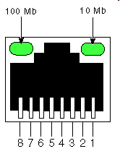
Switching via memory
first generation routers:
traditional computers with switching under direct control of CPU
packet copied to system’s memory
speed limited by memory bandwidth (2 bus crossings per datagram)
input
port
(e.g.,
Ethernet)
output
port
(e.g.,
Ethernet)
memory
system bus

Slide 20
Switching via a bus
datagram from input port memory to output port memory via a shared bus
bus contention: switching speed limited by bus bandwidth
32 Gbps bus, Cisco 5600: sufficient speed for access routers

Slide 21
Switching via interconnection network
Crossbar, Clos networks, other interconnection nets initially developed to connect processors in multiprocessor
multistage switch: nxn switch from multiple stages of smaller switches
3x3 crossbar
3x3 crossbar
exploiting parallelism:
fragment datagram into fixed length cells on entry
switch cells through the fabric, reassemble datagram at exit
8x8 multistage switch
built from smaller-sized switches

Slide 22
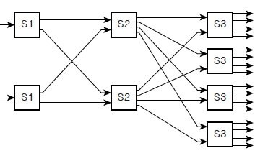
Switching via interconnection network
scaling, using multiple switching “planes” in parallel:
speedup, scaleup via parallelism
Cisco CRS router:
basic unit: 8 switching planes
each plane: 3-stage interconnection network
up to 100’s Tbps switching capacity
fabric plane 0
fabric plane 1
fabric plane 2
. . .
. . .
fabric plane 3
. . .
. . .
fabric plane 4
. . .
. . .
fabric plane 5
. . .
. . .
fabric plane 6
. . .
. . .
fabric plane 7
. . .
. . .
. . .
. . .
. . .
. . .

Slide 23
Input port queuing
If switch fabric slower than input ports combined -> queueing may occur at input queues
queueing delay and loss due to input buffer overflow!
Head-of-the-Line (HOL) blocking: queued datagram at front of queue prevents others in queue from moving forward
switch
fabric
switch
fabric
output port contention: only one red datagram can be transferred. lower red packet is blocked
one packet time later: green packet experiences HOL blocking

Slide 24

Output port queuing
datagram
buffer
queueing
This is a really important slide
switch
fabric
(rate: NR)
link
layer
protocol
(send)
line
termination
R
Buffering required when datagrams arrive from fabric faster than link transmission rate. Drop policy: which datagrams to drop if no free buffers?
Datagrams can be lost due to congestion, lack of buffers
Scheduling discipline chooses among queued datagrams for transmission
Priority scheduling – who gets best performance, network neutrality

Slide 25
Output port queuing
switch
fabric
switch
fabric
at t, packets more
from input to output
one packet time later
buffering when arrival rate via switch exceeds output line speed
queueing (delay) and loss due to output port buffer overflow!

Slide 26
Buffer Management
buffer management:
drop: which packet to add, drop when buffers are full
tail drop: drop arriving packet
priority: drop/remove on priority basis
datagram
buffer
queueing
scheduling
switch
fabric
link
layer
protocol
(send)
line
termination
R
Abstraction: queue
marking: which packets to mark to signal congestion (ECN, RED)
R
packet
departures
packet
arrivals
queue
(waiting area)
link
(server)

Slide 27
Packet Scheduling: FCFS
packet scheduling: deciding which packet to send next on link
first come, first served
FCFS: packets transmitted in order of arrival to output port
also known as: First-in-first-out (FIFO)
real world examples?
Abstraction: queue
R
packet
departures
packet
arrivals
queue
(waiting area)
link
(server)

